Slide 1
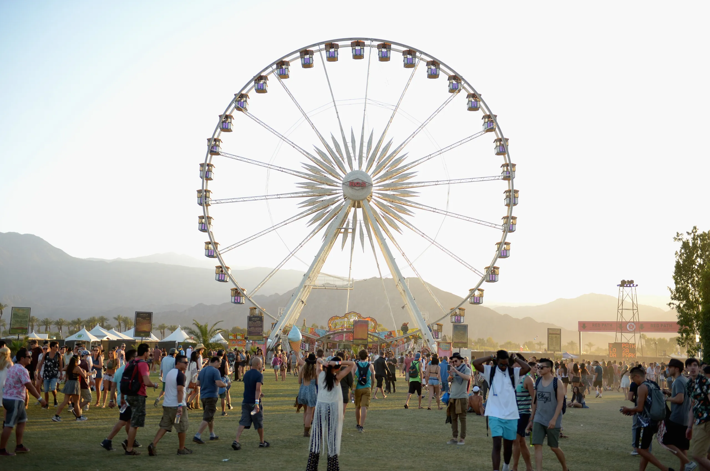
COCKTAIL & NETWORKING
DECEMBER 11TH
INTRO
PRE-TRADE STAGE | 05:05PM
●
ROCK’N’ROLL FT HIP-HOP
POP FT ELECTRO
EXECUTION STAGE | 05:10PM
●
ROCK’N’ROLL FT POP
HIP-HOP FT ELECTRO
POST-TRADE STAGE | 05:20PM
●
QUIZ
BREAKOUT STAGE | 05:30PM
●
FULL MASH UP
AFTER-HOURS STAGE | 05:40PM

Slide 2
COCKTAIL & NETWORKING
DECEMBER 11TH
INTRO
PRE-TRADE STAGE | 05:05PM
●
ROCK’N’ROLL FT HIP-HOP
POP FT ELECTRO
EXECUTION STAGE | 05:10PM
●
ROCK’N’ROLL FT POP
HIP-HOP FT ELECTRO
POST-TRADE STAGE | 05:20PM
●
QUIZ
BREAKOUT STAGE | 05:30PM
●
FULL MASH UP
AFTER-HOURS STAGE | 05:40PM

Slide 3
COCKTAIL & NETWORKING
DECEMBER 11TH
INTRO
PRE-TRADE STAGE | 05:05PM
●
ROCK’N’ROLL FT HIP-HOP
POP FT ELECTRO
EXECUTION STAGE | 05:10PM
●
ROCK’N’ROLL FT POP
HIP-HOP FT ELECTRO
POST-TRADE STAGE | 05:20PM
●
QUIZ
BREAKOUT STAGE | 05:30PM
●
FULL MASH UP
AFTER-HOURS STAGE | 05:40PM

Slide 4
COCKTAIL & NETWORKING
DECEMBER 11TH
INTRO
PRE-TRADE STAGE | 05:05PM
●
ROCK’N’ROLL FT HIP-HOP
POP FT ELECTRO
EXECUTION STAGE | 05:10PM
●
ROCK’N’ROLL FT POP
HIP-HOP FT ELECTRO
POST-TRADE STAGE | 05:20PM
●
QUIZ
BREAKOUT STAGE | 05:30PM
●
FULL MASH UP
AFTER-HOURS STAGE | 05:40PM

Slide 5
COCKTAIL & NETWORKING
DECEMBER 11TH
INTRO
PRE-TRADE STAGE | 05:05PM
●
ROCK’N’ROLL FT HIP-HOP
POP FT ELECTRO
EXECUTION STAGE | 05:10PM
●
ROCK’N’ROLL FT POP
HIP-HOP FT ELECTRO
POST-TRADE STAGE | 05:20PM
●
QUIZ
BREAKOUT STAGE | 05:30PM
●
FULL MASH UP
AFTER-HOURS STAGE | 05:40PM

Slide 6

COCKTAIL & NETWORKING
DECEMBER 11TH
INTRO
PRE-TRADE STAGE | 05:05PM
●
ROCK’N’ROLL FT HIP-HOP
POP FT ELECTRO
EXECUTION STAGE | 05:10PM
●
ROCK’N’ROLL FT POP
HIP-HOP FT ELECTRO
POST-TRADE STAGE | 05:20PM
●
QUIZ
BREAKOUT STAGE | 05:30PM
●
FULL MASH UP
AFTER-HOURS STAGE | 05:40PM

Slide 7
COCKTAIL & NETWORKING
DECEMBER 11TH
INTRO
PRE-TRADE STAGE | 05:05PM
●
ROCK’N’ROLL FT HIP-HOP
POP FT ELECTRO
EXECUTION STAGE | 05:10PM
●
ROCK’N’ROLL FT POP
HIP-HOP FT ELECTRO
POST-TRADE STAGE | 05:20PM
●
QUIZ
BREAKOUT STAGE | 05:30PM
●
FULL MASH UP
AFTER-HOURS STAGE | 05:40PM

Slide 8
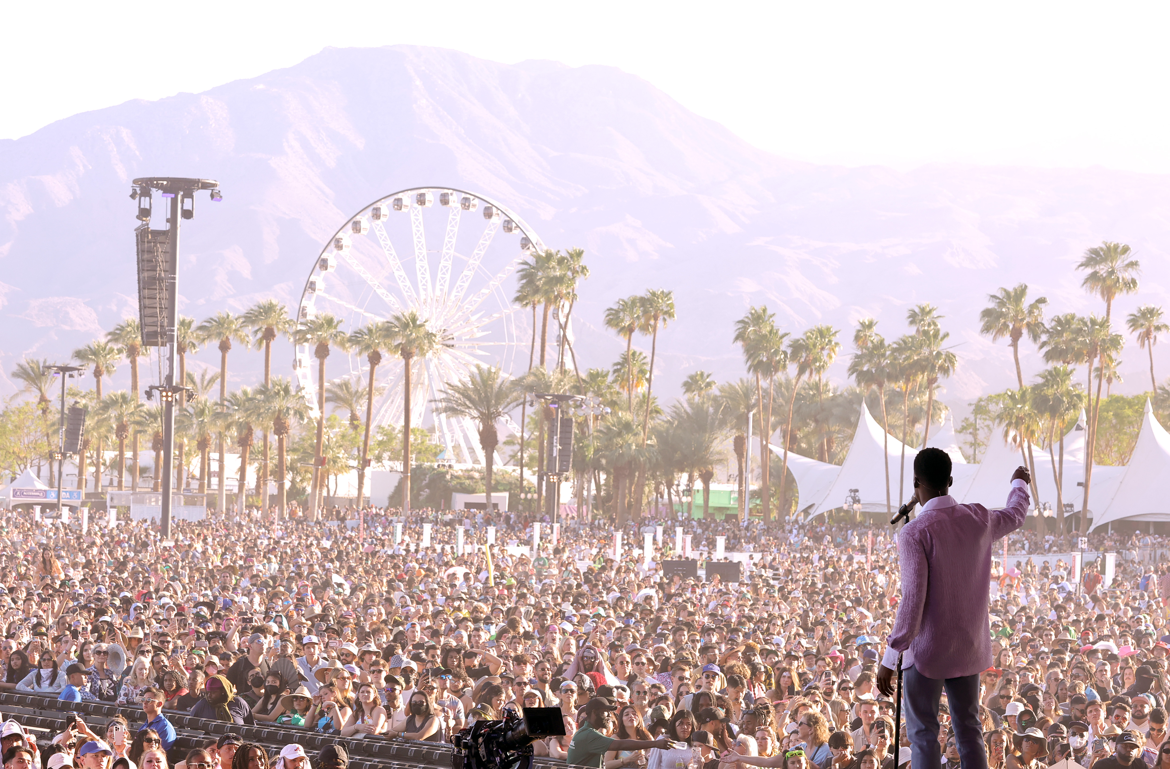

Slide 9
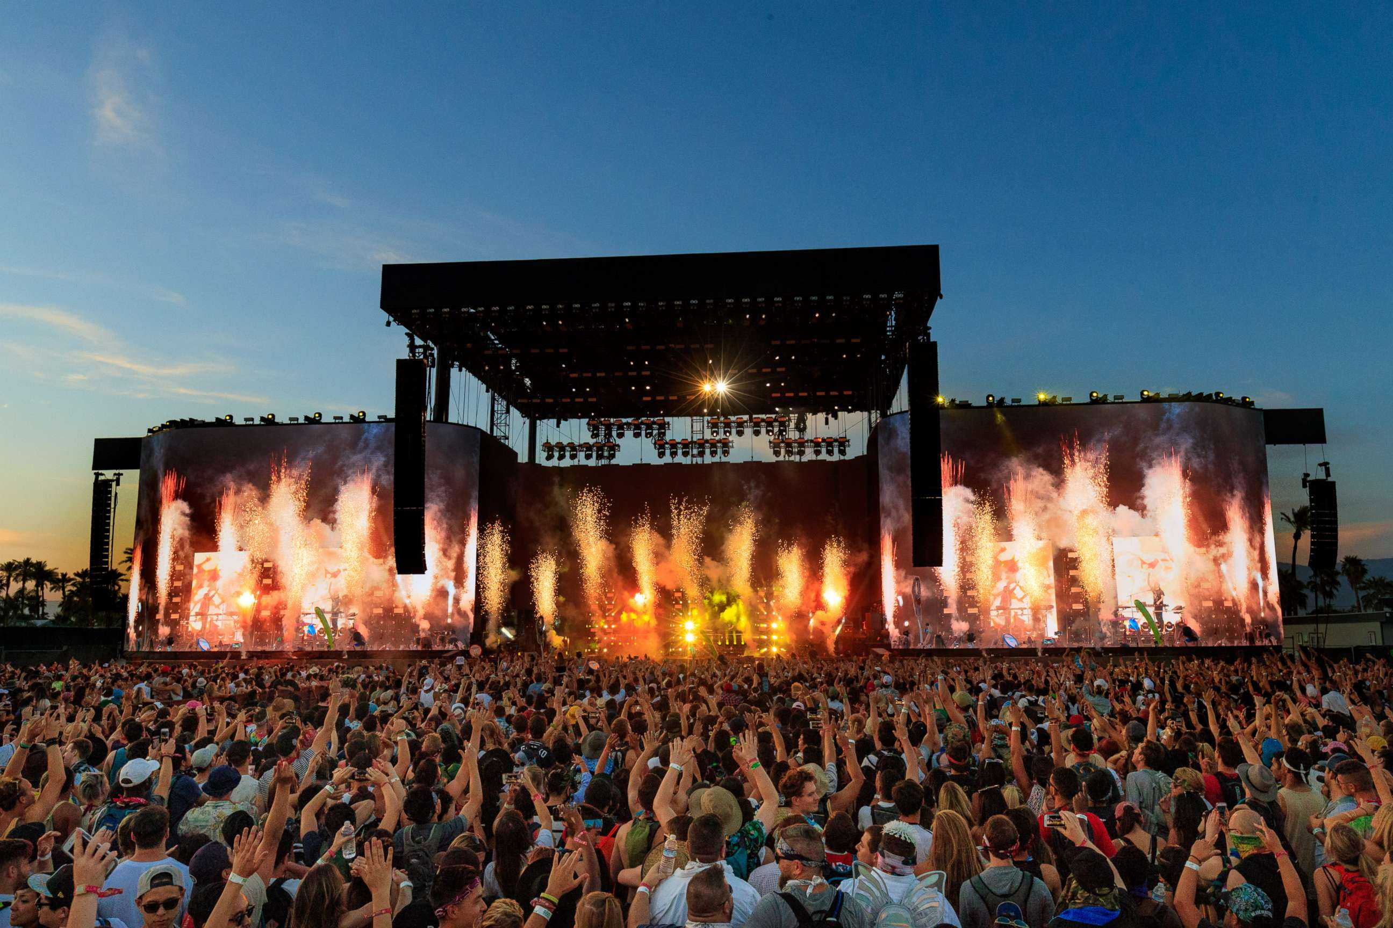

Slide 10
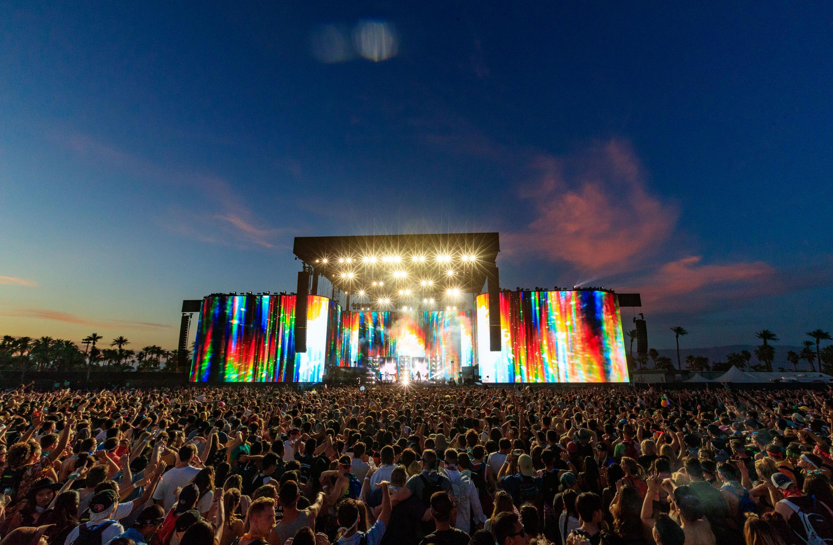

Slide 11
APPENDIX

Slide 12




COCKTAIL & NETWORKING
DECEMBER 11TH
INTRO
05:00PM
YOU ARE HERE
STAGE
1
DRINKING ZONE
STAGE
2
ROCK’N’ROLL FT HIP-HOP
JAZZ FT ELECTRO
05:05PM
ROCK’N’ROLL FT JAZZ
HIP-HOP FT ELECTRO
05:15PM
QUIZ
05:30PM

Slide 13
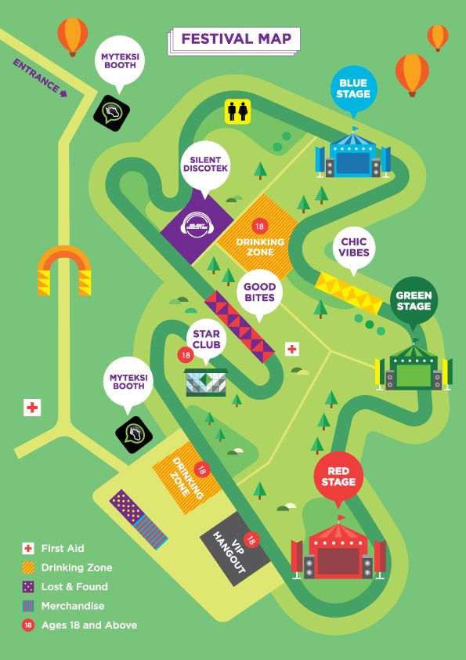

INTRO
05:00PM
YOU ARE HERE
STAGE
1
DRINKING ZONE
STAGE
2
ROCK’N’ROLL FT HIP-HOP
JAZZ FT ELECTRO
05:05PM
ROCK’N’ROLL FT JAZZ
HIP-HOP FT ELECTRO
05:15PM
QUIZ
05:30PM

Slide 14
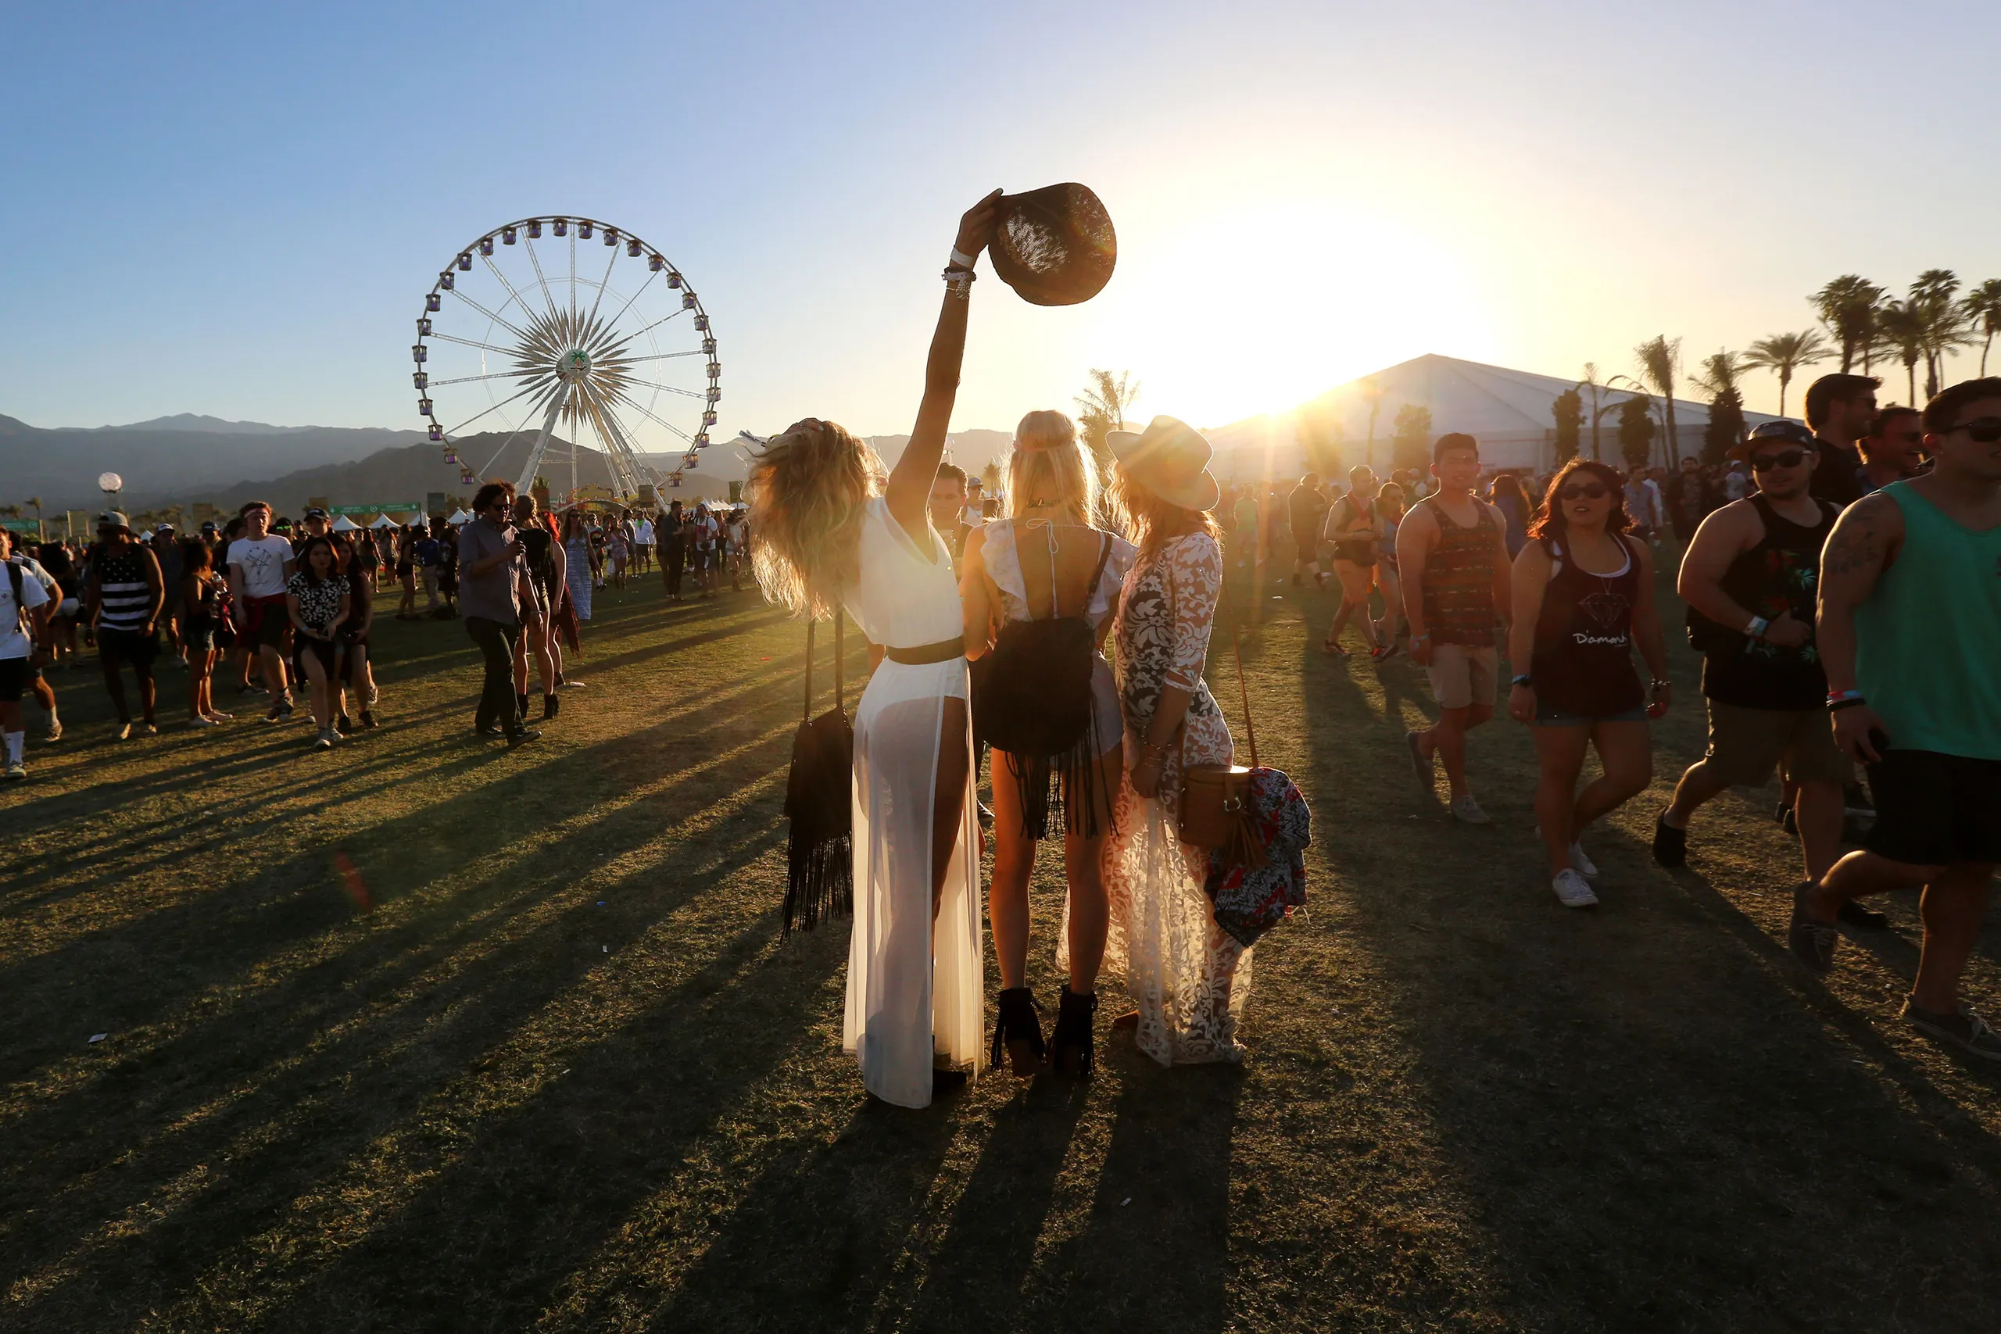
COCKTAIL & NETWORKING
DECEMBER 11TH
INTRO
05:00PM
ROCK’N’ROLL FT DISCO
JAZZ FT POP
05:05PM
ROCK’N’ROLL FT JAZZ
DISCO FT POP
05:15PM
SPEECH
05:25PM
QUIZ
05:30PM
FULL MASH UP
05:40PM

Slide 15

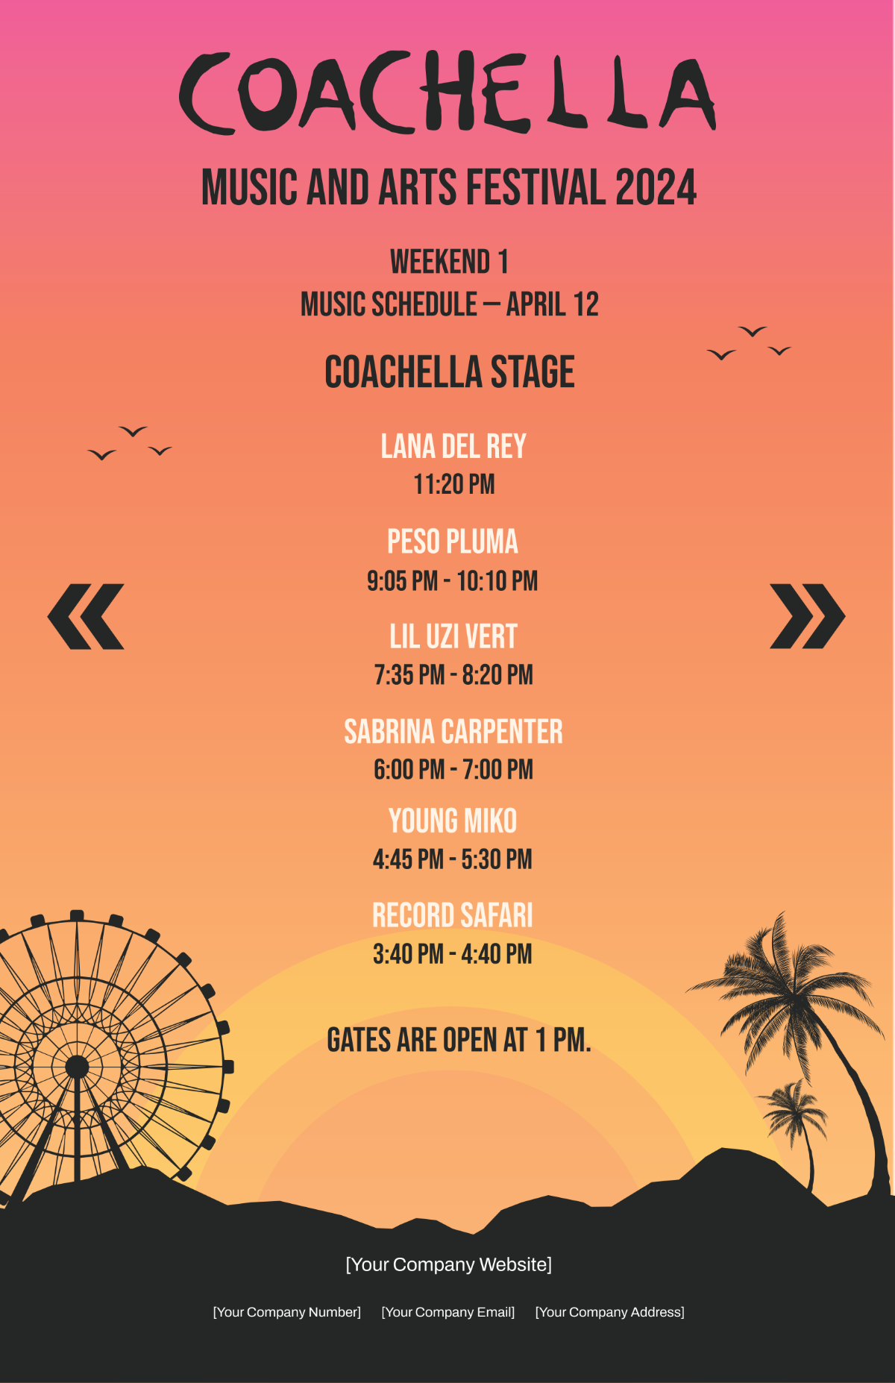
COCKTAIL & NETWORKING
DECEMBER 11TH
INTRO
05:00PM
ROCK’N’ROLL FT DISCO
JAZZ FT POP
05:05PM
ROCK’N’ROLL FT JAZZ
DISCO FT POP
05:15PM
SPEECH
05:25PM
QUIZ
05:30PM
FULL MASH UP
05:40PM

Slide 17
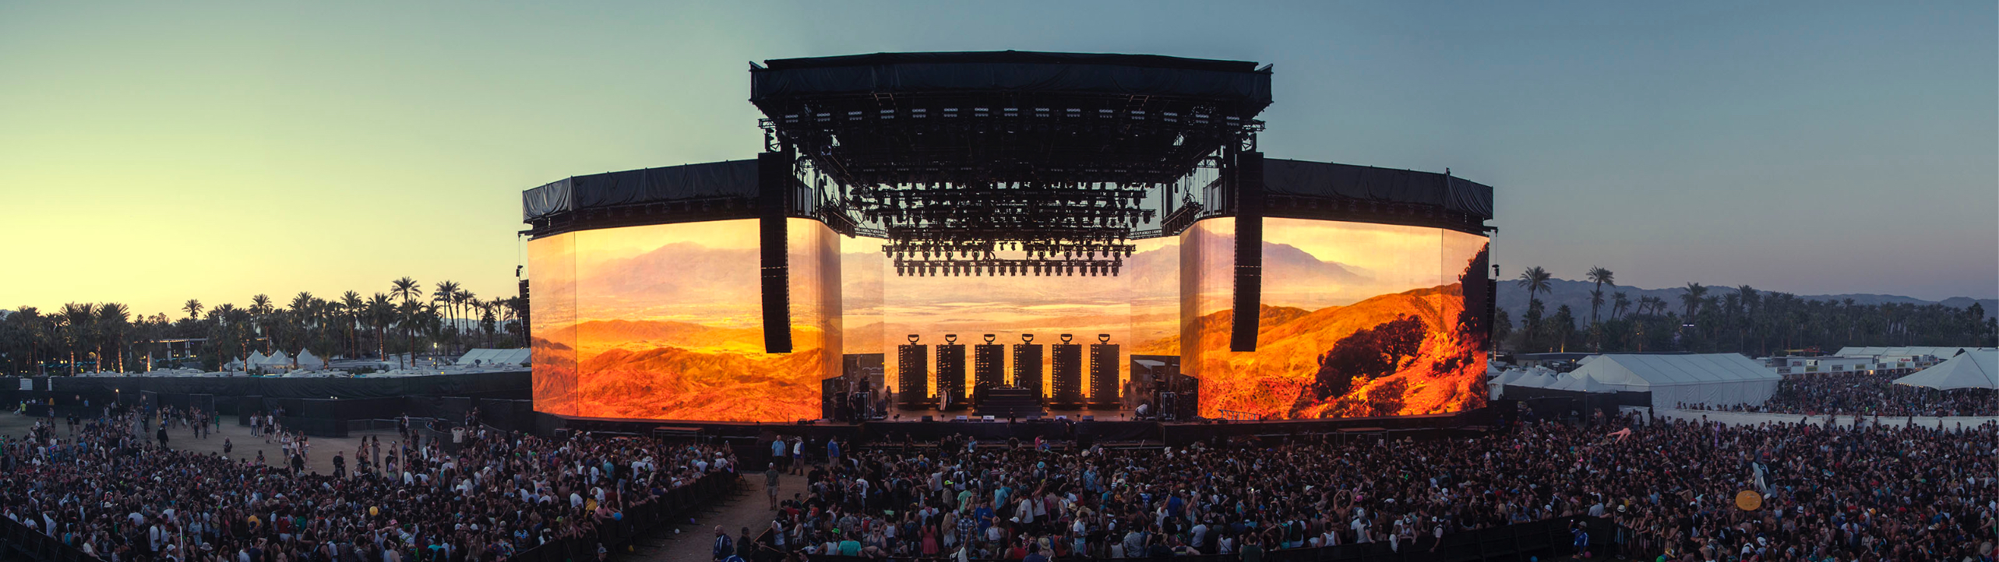

Slide 23
COCKTAIL & NETWORKING
DECEMBER 11TH
INTRO
05:00PM
ROCK’N’ROLL FT DISCO
JAZZ FT POP
05:05PM
ROCK’N’ROLL FT JAZZ
DISCO FT POP
05:15PM
SPEECH
05:25PM
QUIZ
05:30PM
FULL MASH UP
05:40PM

Slide 24
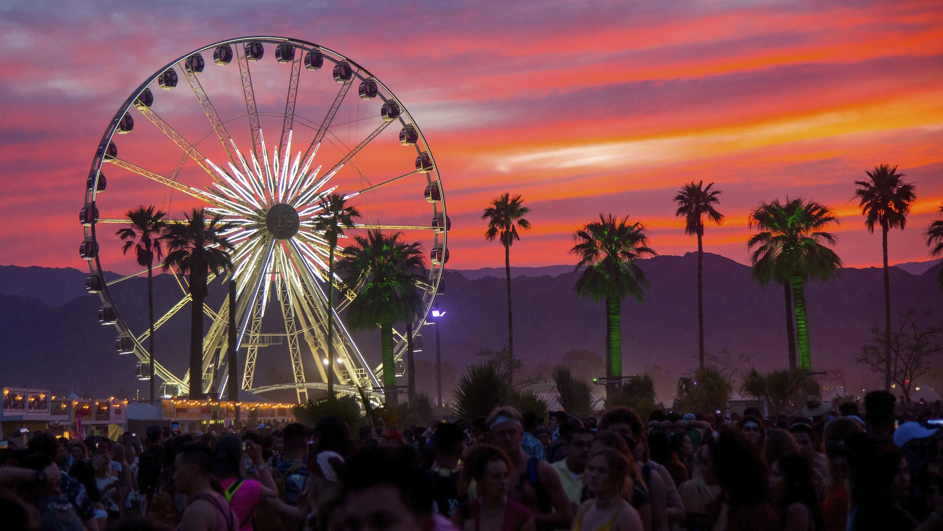
COCKTAIL & NETWORKING
DECEMBER 11TH
INTRO
05:00PM
ROCK’N’ROLL FT DISCO
JAZZ FT POP
05:05PM
ROCK’N’ROLL FT JAZZ
DISCO FT POP
05:15PM
SPEECH
05:25PM
QUIZ
05:30PM
FULL MASH UP
05:40PM

Slide 25
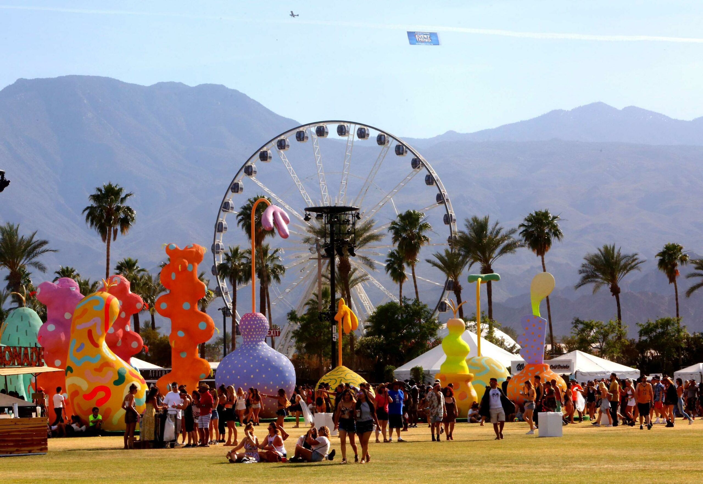

Slide 26
COCKTAIL & NETWORKING
DECEMBER 11TH
INTRO
05:00PM
ROCK’N’ROLL FT DISCO
JAZZ FT POP
05:05PM
ROCK’N’ROLL FT JAZZ
DISCO FT POP
05:15PM
SPEECH
05:25PM
QUIZ
05:30PM
FULL MASH UP
05:40PM

Slide 27
COCKTAIL & NETWORKING
DECEMBER 11TH
INTRO
05:00PM
ROCK’N’ROLL FT DISCO
JAZZ FT POP
05:05PM
ROCK’N’ROLL FT JAZZ
DISCO FT POP
05:15PM
SPEECH
05:25PM
QUIZ
05:30PM
FULL MASH UP
05:40PM

Slide 28
COCKTAIL & NETWORKING
DECEMBER 11TH
INTRO
05:00PM
ROCK’N’ROLL FT DISCO
JAZZ FT POP
05:05PM
ROCK’N’ROLL FT JAZZ
DISCO FT POP
05:15PM
SPEECH
05:25PM
QUIZ
05:30PM
FULL MASH UP
05:40PM

Slide 29
COCKTAIL & NETWORKING
DECEMBER 11TH
INTRO
05:00PM
ROCK’N’ROLL FT DISCO
JAZZ FT POP
05:05PM
ROCK’N’ROLL FT JAZZ
DISCO FT POP
05:15PM
SPEECH
05:25PM
QUIZ
05:30PM
FULL MASH UP
05:40PM

Slide 30
COCKTAIL & NETWORKING
DECEMBER 11TH
INTRO
05:00PM
ROCK’N’ROLL FT DISCO
JAZZ FT POP
05:05PM
ROCK’N’ROLL FT JAZZ
DISCO FT POP
05:15PM
SPEECH
05:25PM
QUIZ
05:30PM
FULL MASH UP
05:40PM

